Slide 1
COMP 2000
Week 13 - Wednesday

Slide 2
Last time
What did we talk about last time?
Software engineering
Modeling and UML
  Activity diagrams
  Use case diagrams
  Sequence diagrams
  State diagrams
  Class diagrams
Architecture patterns

Slide 3
Questions?

Slide 4
Project 4

Slide 5
Testing

Slide 6
Testing
Testing can only show the presence of errors, not their absence.
  Edsger Dijkstra
Historically, testing has sometimes been a task given to junior developers
As systems have gotten more complex, people have gotten more excited about testing
Finding ways to test subtle aspects of a program can be a rewarding challenge

Slide 7
Purposes of testing
There are two almost opposing purposes for testing
Showing that software meets its requirements
  Validation testing
  Looking for good outputs
Finding inputs where software doesn't work
  Defect testing
  Looking for bad outputs
When a project is due, students often confuse the two
  Trying to convince themselves that the code is fine instead of looking for problems

Slide 8
Stages of testing
Commercial software systems often go through three stages of testing
Development testing
  Look for bugs during development
  Designers and programmers do the testing
Release testing
  Test a complete version of the code to see if it meets requirements
  A separate testing team does the testing
User testing
  Users test the system in a real environment
  Acceptance testing is a special kind of user testing to decide whether or not the product should be accepted or sent back

Slide 9
Development testing
Development testing is the idea of testing you're most familiar with
  Testing the software as it's being developed
  Development testing is focused on defect testing
  Debugging happens alongside development testing
Three stages of development testing:
  Unit testing: testing individual classes or methods
  Component testing: testing components made from several objects
  System testing: testing the system as a whole

Slide 10
Unit testing
Unit testing focuses on very small components
  Methods or functions
  Objects
Unit tests try many different inputs for the methods or objects to make sure that the outputs match

Slide 11
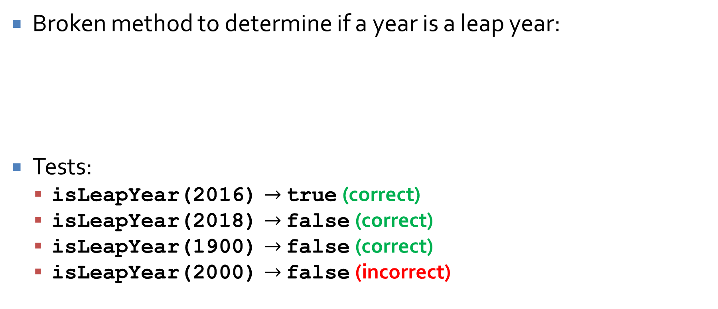
Unit test example
Broken method to determine if a year is a leap year:
Tests:
  isLeapYear(2016) $→$ true (correct)
  isLeapYear(2018) $→$ false (correct)
  isLeapYear(1900) $→$ false (correct)
  isLeapYear(2000) $→$ false (incorrect)
public static boolean isLeapYear(int year) {
return year % 4 == 0 && year % 100 != 0;
}

Slide 12
Automated tests
Because unit tests are based on simple relationships between input and expected output, they can usually be automated
  And they totally should be
Automated tests have three parts:
  Setup: initialize the system with the inputs and expected outputs
  Call: call the method you're testing
  Assertion: compare the real output with the expected output

Slide 13
Automated testing frameworks
You can create unit tests by hand and run them
However, the problem is so universal that many automated testing frameworks have been created
The most famous for Java is JUnit
  Wikipedia lists about 50 just for Java
  Some have special strengths, like creating mock objects that behave in ways that are useful for testing
These testing frameworks make it easier to generate and run the tests

Slide 14
Choosing unit test cases
Effective tests will show:
  When used as expected, a component does what it's supposed to
  Defects, if there are any, in a component
In testing terminology, these are called positive tests (showing that stuff works) and negative tests (trying to make things crash)
It's hard to pick good test cases

Slide 15
Choosing unit test cases, continued
Two strategies for picking test cases:
  Partition testing
    Identify groups of inputs that will be processed in the same way
    Pick representatives from each group
  Guideline-based testing
    Use guidelines to choose test cases
    Guidelines are based on experience about the kinds of errors that programmers often make

Slide 16
Equivalence partitioning
Partition testing is based on the observation that programs often behave similarly for all members of a set of values
Such a set is called an equivalence partition
You can try to find a set of equivalence partitions that covers all behaviors

Slide 17
Examples of guidelines
When dealing with sequences, arrays, and lists, consider:
  Testing software with sequences that have a single value (or no values)
  Use sequences of different sizes in different tests
  Design tests that access the first, middle, and last elements of a sequence

Slide 18
Black box testing
One philosophy of testing is making black box tests
A black box test takes some input A and knows that the output is supposed to be B
It assumes nothing about the internals of the program, only the specification
To write black box tests, you come up with a set of input you think covers lots of cases and you run it and see if it works
In the real world, black box testing can easily be done by a team that did not work on the original development

Slide 19
White box testing
White box testing is the opposite of black box testing
  Sometimes white box testing is called "clear box testing"
In white box testing, you can use your knowledge of how the code works to generate tests
Are there lots of if statements?
  Write tests that go through all possible branches
There are white box testing tools that can help you generate tests to exercise all branches
Which is better, white box or black box testing?

Slide 20
Component testing
Beyond unit testing is component testing
Components are made up of several independent units
The errors are likely to be from interactions between the units
  Hopefully, the individual units have already been unit tested
The interfaces between the units have to be tested
  Parameter interfaces in method calls
  Shared memory interfaces
  Procedural interfaces in which an object implements a set of procedures
  Message passing interfaces

Slide 21
System testing
System testing is when we integrate components together in a version of the whole system
Though similar to component testing, there are differences:
  Older reusable components and commercial components might be integrated with new components
  Components developed by different teams might be integrated for the first time
Sometimes, you only see certain behavior when you get everything together
Try testing all the use cases you expect the system to see

Slide 22
JUnit

Slide 23
JUnit
JUnit is a popular framework for automating the unit testing of Java code
JUnit is built into Eclipse and many other IDEs
It is possible to run JUnit from the command line after downloading appropriate libraries
JUnit is one of many xUnit frameworks designed to automate unit testing for many languages
You are required to make JUnit tests for Project 4
JUnit 5 is the latest version of JUnit, and there are small differences from previous versions

Slide 24
JUnit classes
For each set of tests, create a class
Code that must be done ahead of every test has the @BeforeEach annotation
Each method that does a test has the @Test annotation
import org.junit.jupiter.api.*;
public class Testing {
private String creature;
@BeforeEach
public void setUp() {
creature = "Wombat";
}
@Test
public void testWombat() {
Assertions.assertEquals("Wombat", creature, "Wombat failure");
}
}

Slide 25
Assertions
An assertion is something that must be true in a program
Java (4 and higher) has assertions built in
You can put the following in code somewhere:
If the condition before the colon is true, everything is fine
If the condition is false, an AssertionError will be thrown with the message after the colon
Caveat: The JVM normally runs with assertions turned off, for performance reasons
You have to run it with assertions on for assertion errors to happen
You should run the JVM with assertions on for testing purposes
String word = "phlegmatic";
assert word.length() < 5 : "Word is too long!";

Slide 26
Assertions in JUnit tests
When you run a test, you expect to get a certain output
You should assert that this output is what it should be
JUnit 5 has a class called Assertions that has a number of static methods used to assert that different things are what they should be
  Running JUnit takes care of turning assertions on
The most common is assertEquals(), which takes the expected value, the actual value, and a message to report if they aren't equal:
  assertEquals(int expected, int actual, String message)
  assertEquals(char expected, char actual, String message)
  assertEquals(double expected, double actual, double delta, String message)
  assertEquals(Object expected, Object actual, String message)
Another useful method in Assertions:
  assertTrue(boolean condition, String message)

Slide 27
Assertion example
We know that the substring() method on String objects works, but what if we wanted to test it?
import org.junit.jupiter.api.*;
public class StringTest {
@Test
public void testSubstring() {
String string = "dysfunctional";
String substring = string.substring(3,6);
Assertions.assertEquals("fun", substring, "Substring failure!");
}
}

Slide 28
Sometimes failing is winning
What if a method is supposed to throw an exception under certain conditions?
It should be considered a failure not to throw an exception
The Assertions class also has a fail() method that should never be called
import org.junit.jupiter.api.*;
public class FailTest {
@Test
public void testBadString() {
String string = "armpit";
try {
int number = Integer.parseInt(string);
Assertions.fail("An exception should have been thrown!");
}
catch(NumberFormatException e) {}
}
}

Slide 29
JUnit practice
Imagine you've got a method with the following signature that can determine whether or not a String is a palindrome
  Assume it's a sophisticated function that ignores case and punctuation
What are good tests for it?
Let's write at least four JUnit tests for it, covering cases when phrase is a palindrome and when it isn't
public static boolean isPalindrome(String phrase)

Slide 30
Complex class
Consider the following Complex class, for holding real and imaginary numbers
public class Complex {
final double real;
final double imaginary;
public Complex(double real, double imaginary) {
this.real = real;
this.imaginary = imaginary;
}
public double getReal() {
return real;
}
public double getImaginary() {
return imaginary;
}
}

Slide 31
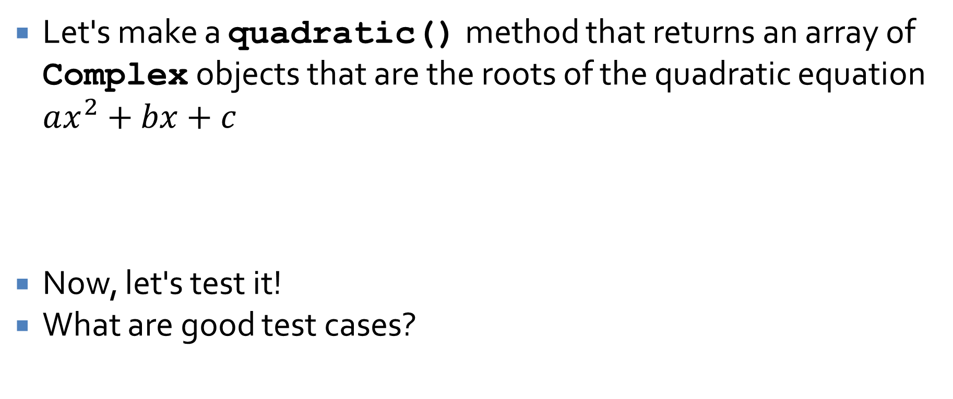
JUnit practice
Let's make a quadratic() method that returns an array of Complex objects that are the roots of the quadratic equation $ax^{2}+bx+c$
Now, let's test it!
What are good test cases?
public static Complex[] quadratic(double a, double b, double c) {
// Fill in code
}

Slide 32
Quiz

Slide 33
Upcoming

Slide 34
Next time…
More JUnit examples

Slide 35
Reminders
Work on Project 4

